Slide 1

Mobile in Dreamlab

Slide 2
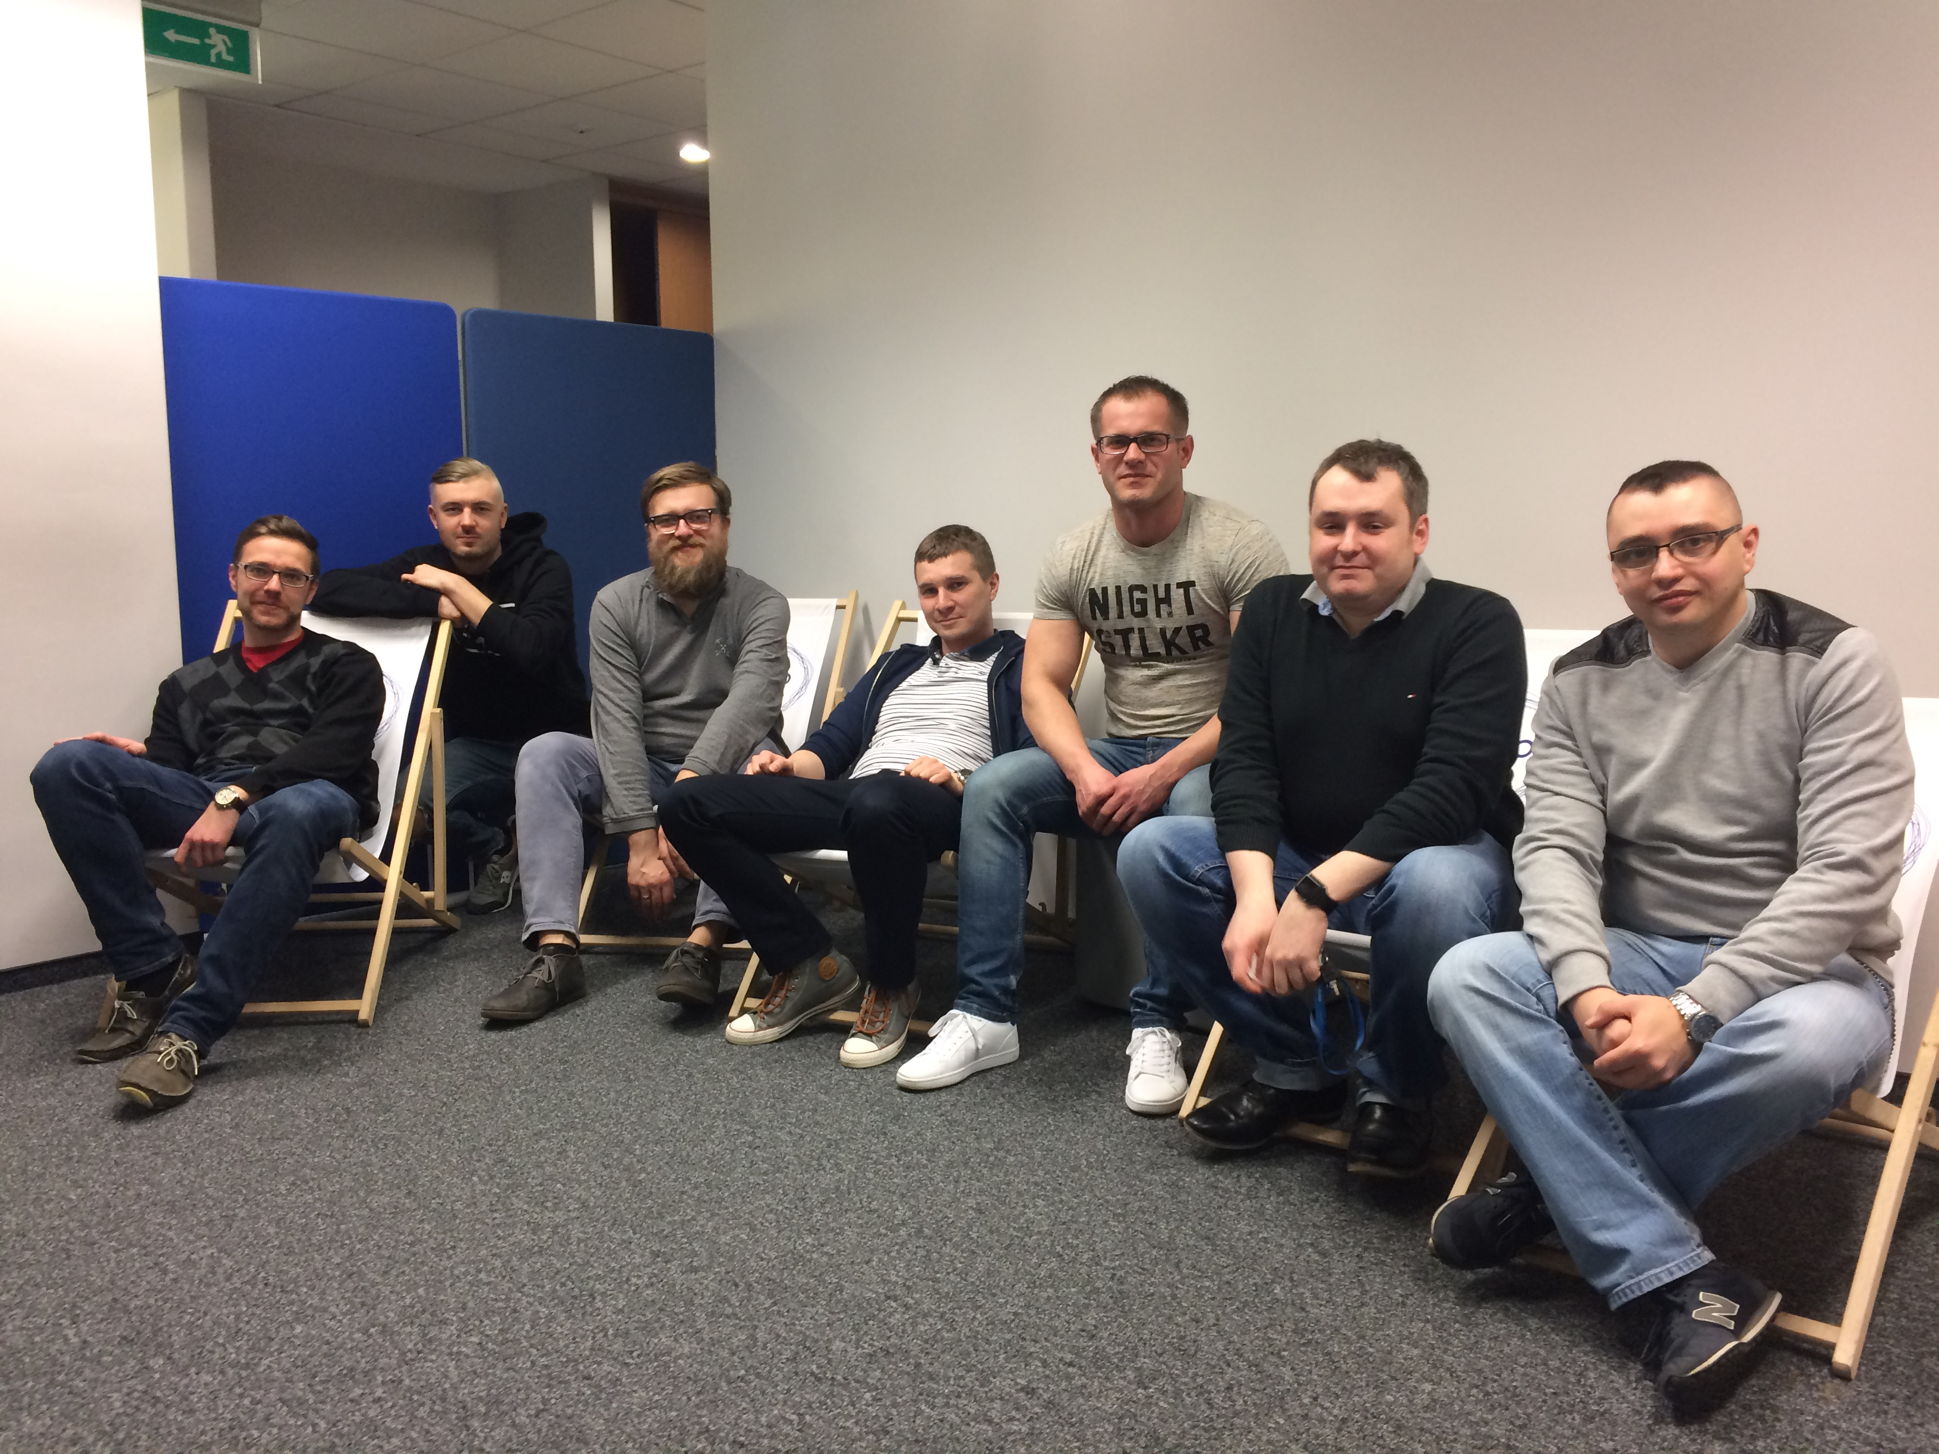
Our team
Michał Nierebiński iOS Leader, Senior iOS Developer
Łukasz Kalbarczyk Systems Architect
Marcin Wałęsa Android Leader, Systems Architect
Radosław Wawrzyniak Senior Android Developer
Zbigniew Dzido Senior Android Developer
Kamil Fert Android Developer
Dariusz Jurczyk Product Owner

Slide 3




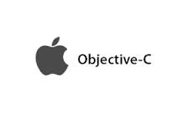



Mobile competencies
Mobile platforms: Android & iOS
Programming languages: Java & Swift/Obj-C
Development environment: Android Studio & Xcode
Testing tools & frameworks: Espresso, Mockito, junit, powermock & XCTest
Dependency manager: Cocoapods & Gradle/Maven
Continuous Integration: Bamboo
Architecture: All recognized architectures (MVC/MVP, MVVM) including modern ones based on Clean architecture approach and event-driven programming
Other tools: Fastlane, Bluepill, Vagrant, Docker

Slide 4
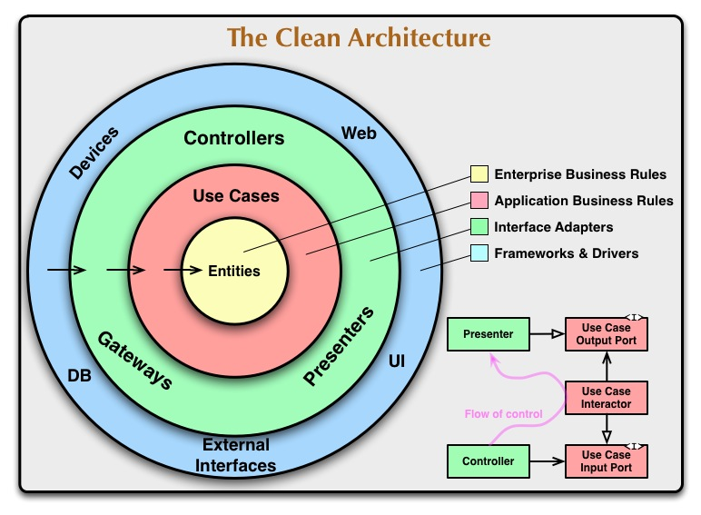
Architecture
Clean Architecture (Android)
Viper (iOS)

Slide 5
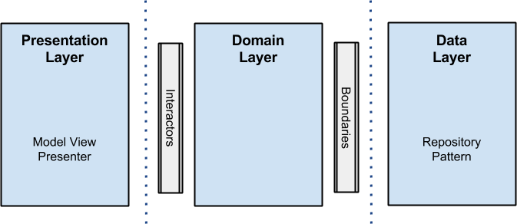
Clean Architecture / Viper
Testable
Independent of Frameworks
Independent of UI
Independent of Database
Independent of any external agency

Slide 6





Continuous Delivery
We apply Atlassian environment to realize
Continuous Delivery strategy to release software
in multi-variant approach.

Slide 7
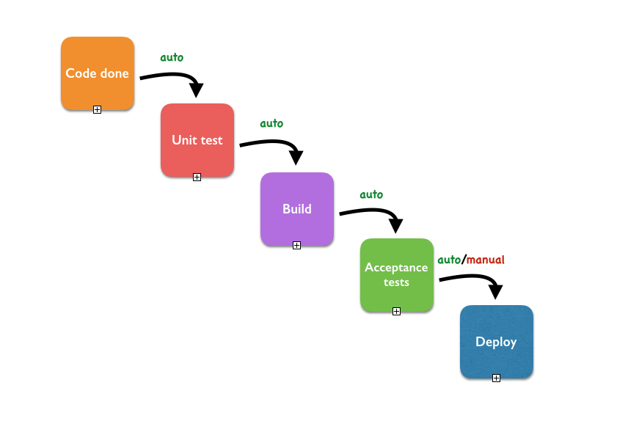
Continuous Delivery
More than just code:
We rely on testing or solutions
We automate our builds
We can release and deliver with one click

Slide 8
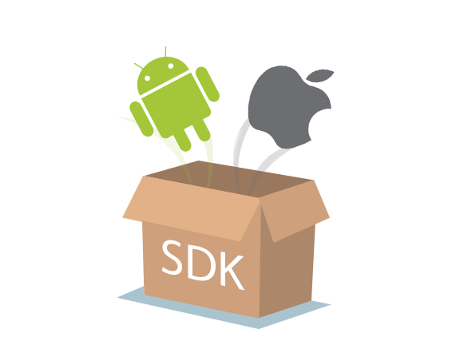
Mobile SDK
Mobile SDK – set of modules which realizes common services or functionalities for apps.
We can build apps with usage of our Mobile SDK what can speed up apps development and decrease their development costs.

Slide 9

Mobile SDK
~ 25 modules per platform
List, Deatil, Analitycs, API, Ads, Gallery, Font, OCDN, FB Comments, Privacy, Push Notifications, WebView, ErrorView, Social Bar, Widget and much more

Slide 10
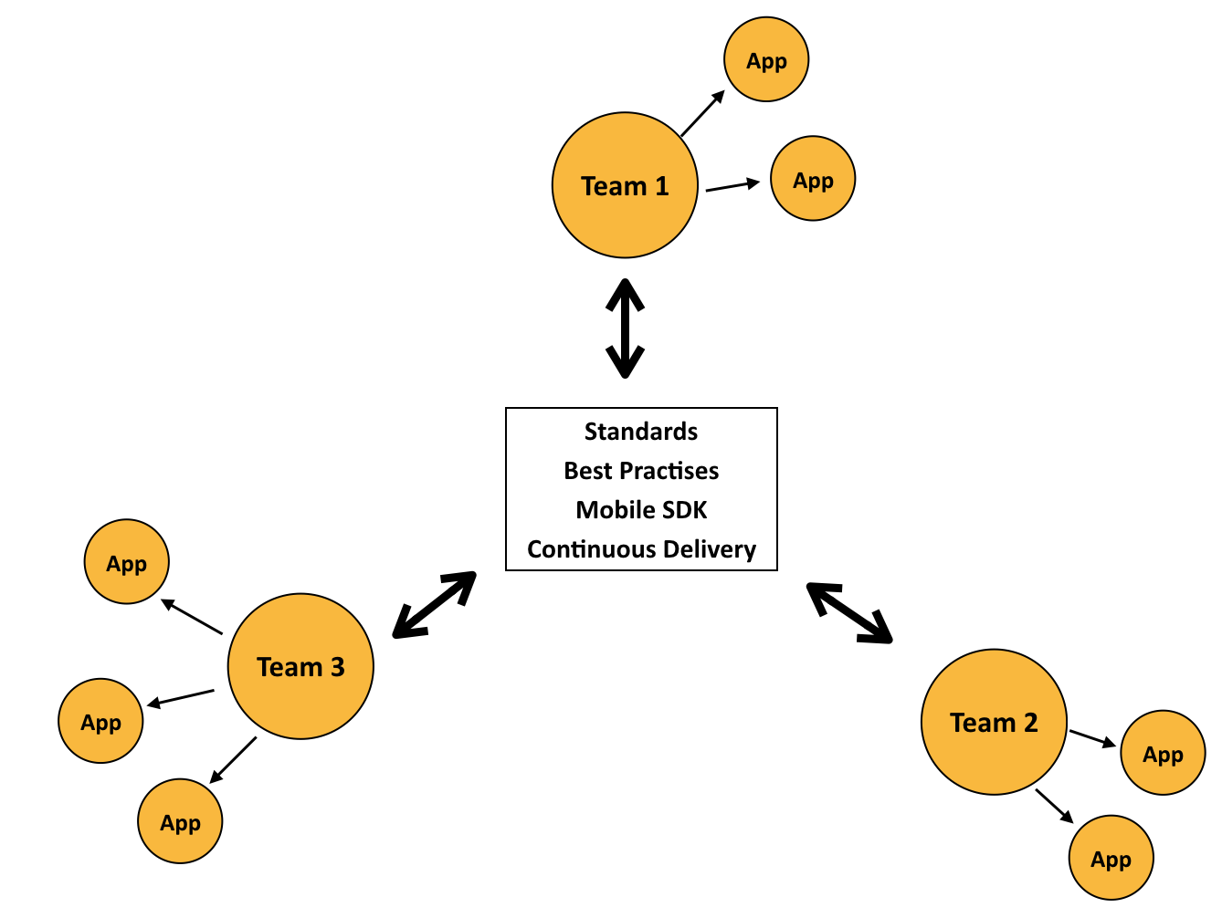
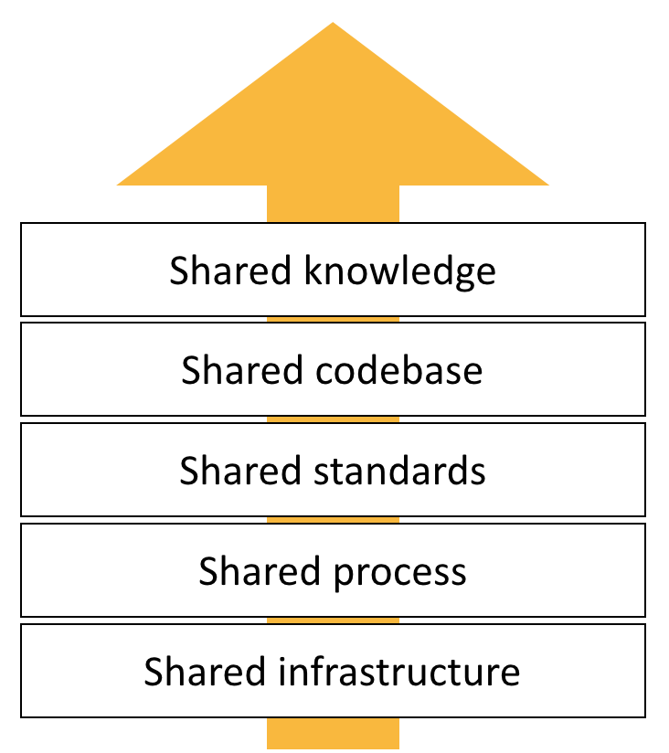
Our Mobile organization
Development cost decrease
Development speed increase
Standardization
Maintenance cost decrease
Mobile teams

Slide 11






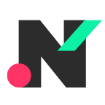
Mobile apps
Onet
Blic
Business Insider PL
Forbes
Fakt24
Ofeminin
Noizz PL

Slide 12
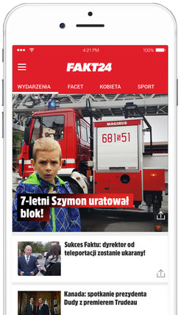
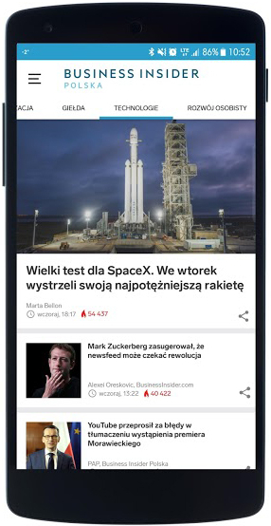
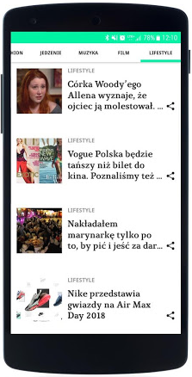
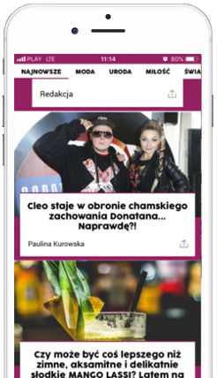
App Template
What is AppTemplate?
A set of modules configured and integrated in a way that allows us to develop new apps really quickly

Slide 13
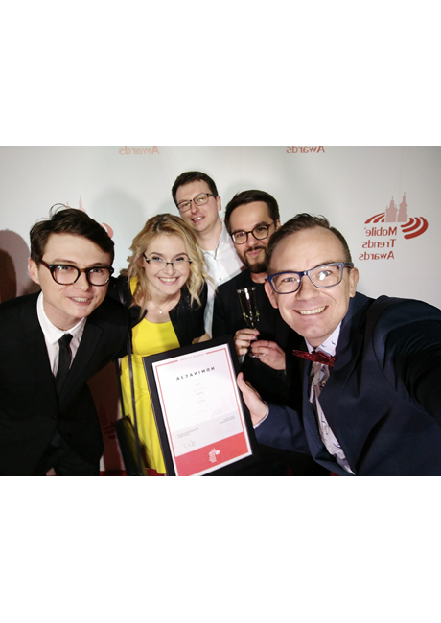
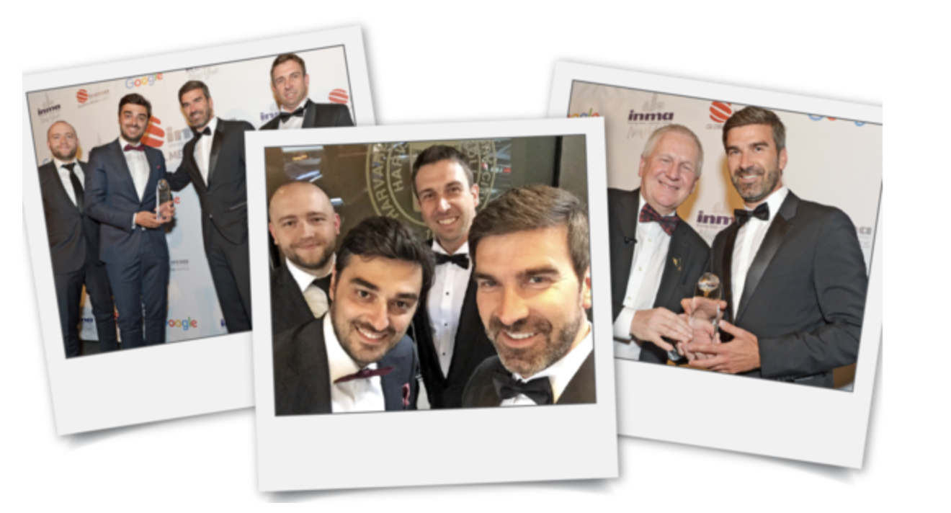
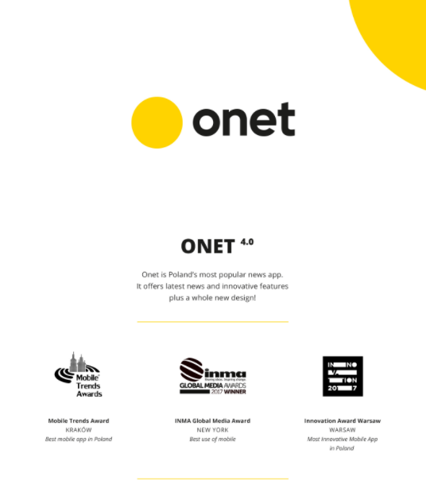
Awards and recognition
Onet 4.0 app wins INMA Global Media Award 2017 in Best Use of Mobile Category
Onet 4.0 app wins Mobile Trends Award in Best Mobile App Category

Slide 14
Thank You

